Slide 1
Building A Quadcopter in 10 Weeks
To achieve great things, two things are needed: a plan and not quite enough time.
--Leonard Bernstein
Homepage: http://goo.gl/XYwuoy

Slide 2
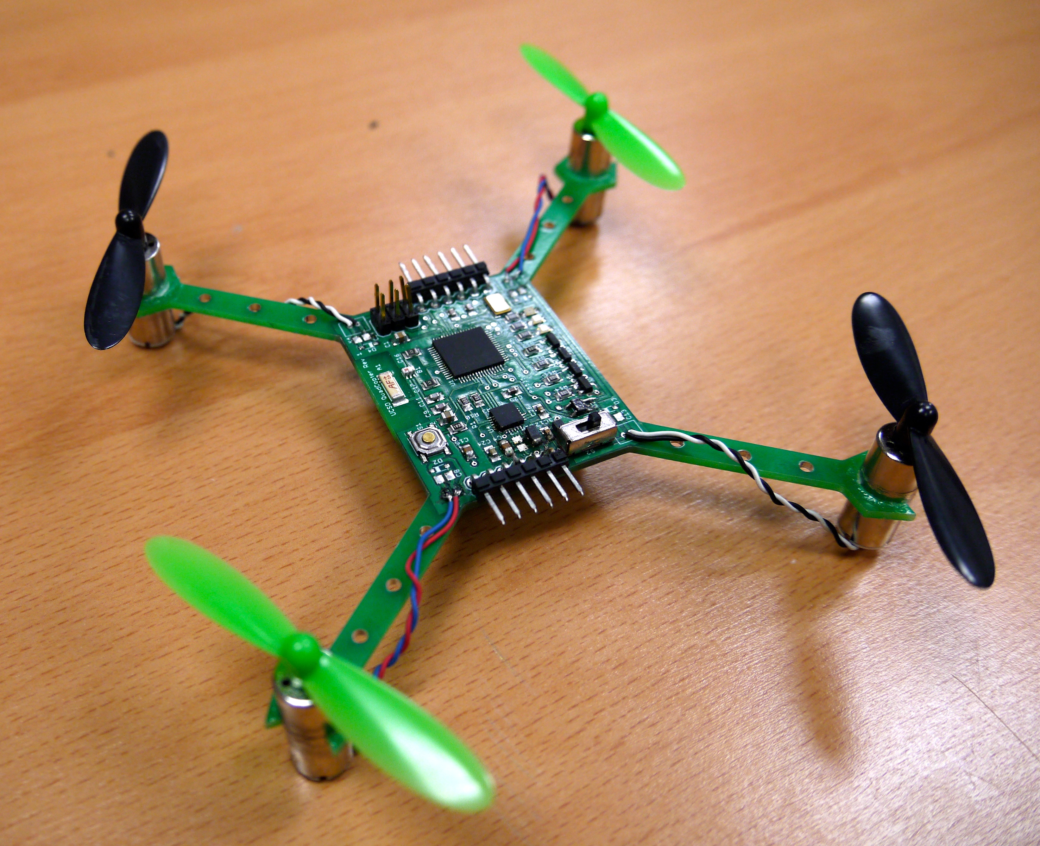
Course Goals
Build several small quadcopter
In 10 weeks
Mostly “from scratch”
Learn
Basic PCB design
How to integrate diverse hardware/software components
About quadcopter-related technologies

Slide 3
Course Schedule Outline
Main goal: Start testing/refining flight control software on your quadcopter ASAP.
Weeks 1-5: Sprint to a PCB design, do preliminary software development
Most important date: May 9th – Board “tape out”
Weeks 6-10: Software refinement, quad assembly, refinement and testing.
Schedule is here: https://goo.gl/LgzvEu

Slide 4
Lab Overviews

Slide 5
The Lab Schedule
The lab schedule is very aggressive
Preparatory labs (1-4): 2 weeks
There’s a new lab each class, and they are due one week later.
You will learn all the skills you need to build the quadcopter
Design and manufacturing labs (4,7,8): 3.5 weeks
Design the schematic and board
Manufacture them.
Implement flight control software (5, 6): 4 weeks
Quadcopter and remote firmware development
PID control for quad stability.
Make it work labs (9-10): 4.5 weeks
Make it fly!
Total: 14 weeks!
Do not fall behind!

Slide 6
Lab Structure
Labs are divided into hardware and software labs
Hardware labs require equipment
We will provide it.
You are responsible for it (see policy on course web site)
Software labs require only software and data
You can use the computers here or your own.

Slide 7
Teams
You will work both in groups and on your own
Lab 1 and 2 will be on your own.
The rest are completed in pairs of your choosing.
In all cases, you can help each other out
No direct copying of source code, designs, etc.
Asking questions, etc. is great.
There is no curve in this class – no need to compete.

Slide 8
Lab 1: Learn to Use Eagle
Software Lab
Build design a simple schematic.
Turn it into a board design.
Generate manufacturing data.
Performance manufacturing checks.
Design some new parts for the Eagle library.
Learn to decorate your boards.
This is due Thursday (in 48 hours!!!)

Slide 9
Lab 2: Practice Using Eagle
Software Lab
Build more parts in Eagle.
The IMU
Some discrete components
Hard: Build all the parts.

Slide 10
Lab 3: Wireless Communication
Hardware Lab
Learn how to use the microcontrollers
Arduino IDE
The microcontroller breakout boards
The radios
Experiments
Measure bandwidth, error rate, and range

Slide 11
Lab 4: Start Designing the Quad
Software Lab
Create the schematic
Start with the breakout board schematic.
Connect the IMU
Connect the motor controller
Assemble the power supply circuit
Followed by design review

Slide 12
Lab 5: Other Quadcopter Components
Hardware Lab
Use the remote control to measure gimbal position
Transmit it to the other red board and control a motor accordingly
Read values from an IMU.
Hard: Write some flight control “utilities”

Slide 13
Lab 6: Flight Control Software
Hardware Lab
Implement PID control
Build a remote-controlled, PID stabilized test stand.

Slide 14
Lab 7: Layout the Board
Software Lab
Define the board outline.
Place your parts.
Route the design.
Followed by design review.
Design review

Slide 15
Lab 8: Tape Out!!!
Software Lab
Your designs must be ready for manufacturing by the beginning of class on May 11th.
Early tape out is possible on May 4th.
It will take about a week to manufacture them.

Slide 16
Lab 9: Assembly and Bringup
Hardware Lab
Solder everything to the board
This is non-trivial. The Microcontroller and IMU are challenging packages.
Install the bootloader
Test all the quad subsystems
IMU
Motors
Power
Radio
Debug, Debug, Debug.

Slide 17
Lab 10: Make it Fly!!!
Software and Hardware Lab
Test, adjust, tweak, debug, etc. until its flight is stable.

Slide 18
Logistics

Slide 19
Lab Materials
We will distribute lab materials via github classroom.
You’ll need a github account.
You’ll need to know how to use git.
To access the lab materials, click on the invitation link included in each lab.

Slide 20
Grades and Stuff
No final or exams.
10 Labs
Grading breakdown
50% class participation
50% labs

Slide 21
This is an Intensive, Hands-on Class
Not so much lecturing
Lots of doing.
Your Task
Work Hard
Figure stuff out
Take the initiative
My and Antonella’s Task
Provide high-level guidance
A few lectures
Make sure you have what you need to succeed.

Slide 22
Lab Space
We will meet and work in this room (EnVision -- SME)
You must complete the responsibility contract: http://makerspace.ucsd.edu/access/responsibility.php
Class: 10-11:30
Lab hours
11:30-1:00 on Tuesday and Thursday
Other times TBD

Slide 23
Lab 3: Arduino and Wireless

Slide 24
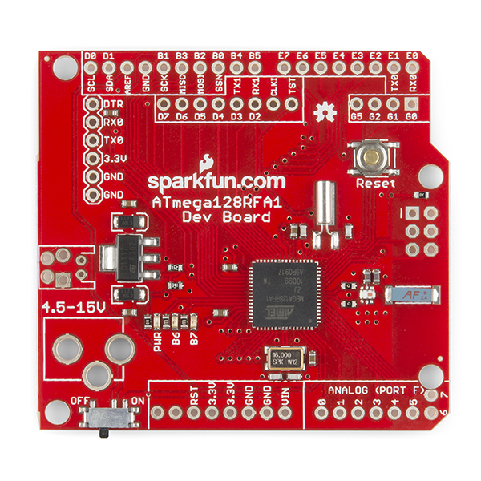
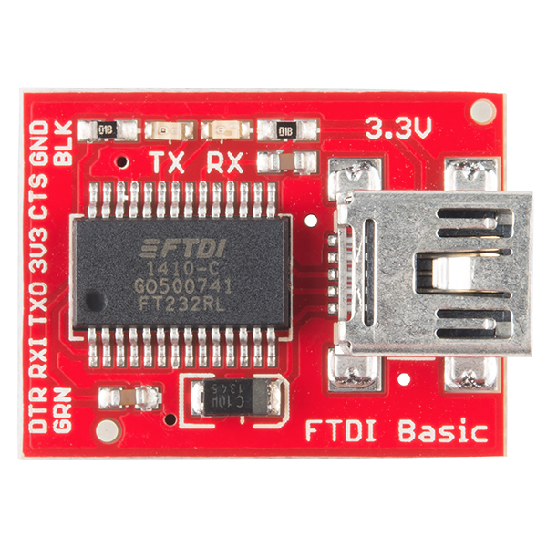
The “Red Board”
Nice breakout board for our microcontroller
Open source
Working radio design
Well-documented
Arduino compatible
Programmable with FTDI USB-to-serial converter
Key component of the controller
Reference design for the quadcopter’s flight computer and radio.

Slide 25
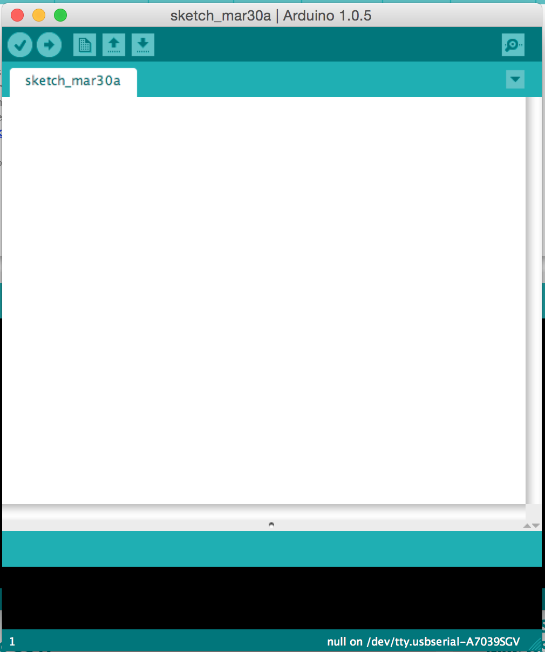
The Arduino IDE
User-friendly IDE for Arduino programming
Programming the microntroller is easy
Installation is easy
Alternatives
Eclipse for Arduino
Official AVR tools from Atmel
You can use them, but they aren’t supported by us.

Slide 26
Tasks
Get wireless working
Download, compile, and install a simple chat program that runs between two red boards.
Push its limits
Do some simple experiments to
Measure range, bandwidth, and the error rate

Slide 27
Quadcopters

Slide 28
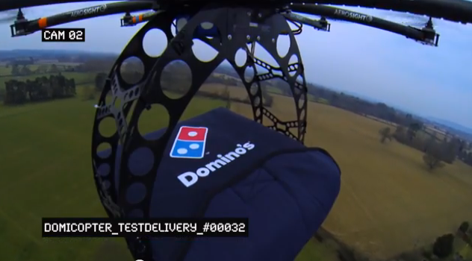
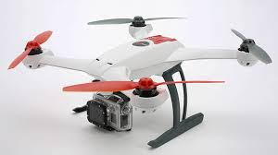
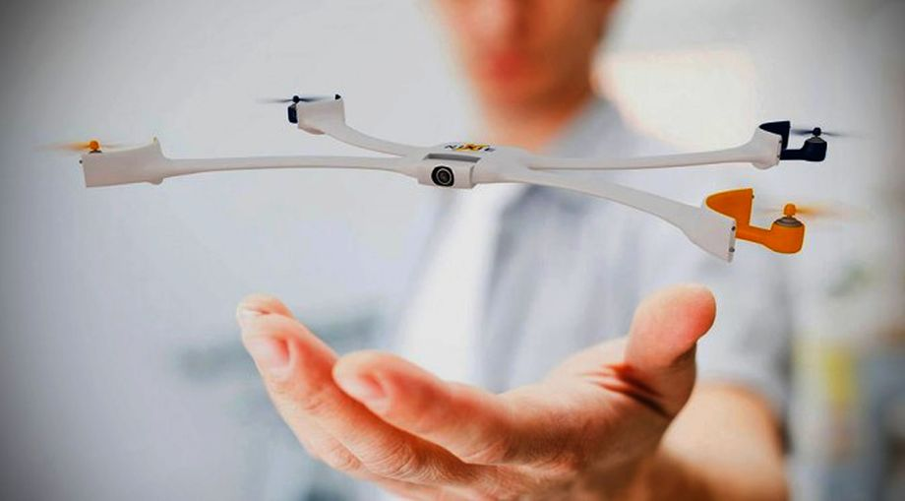
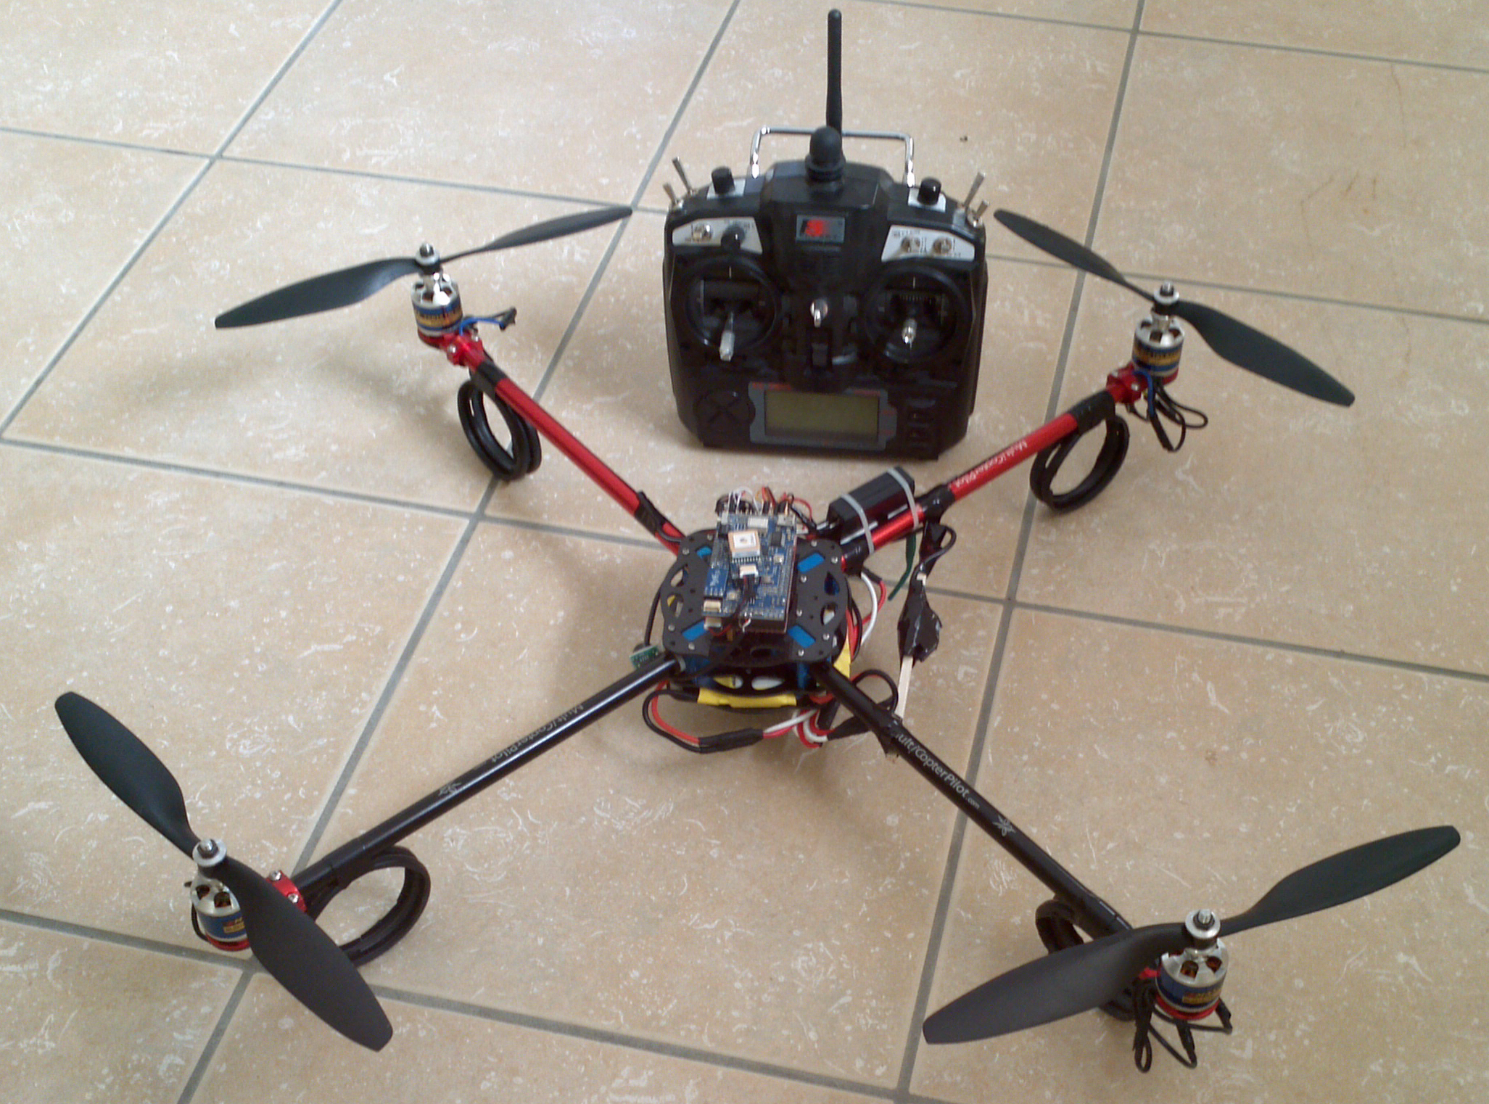
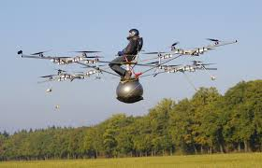
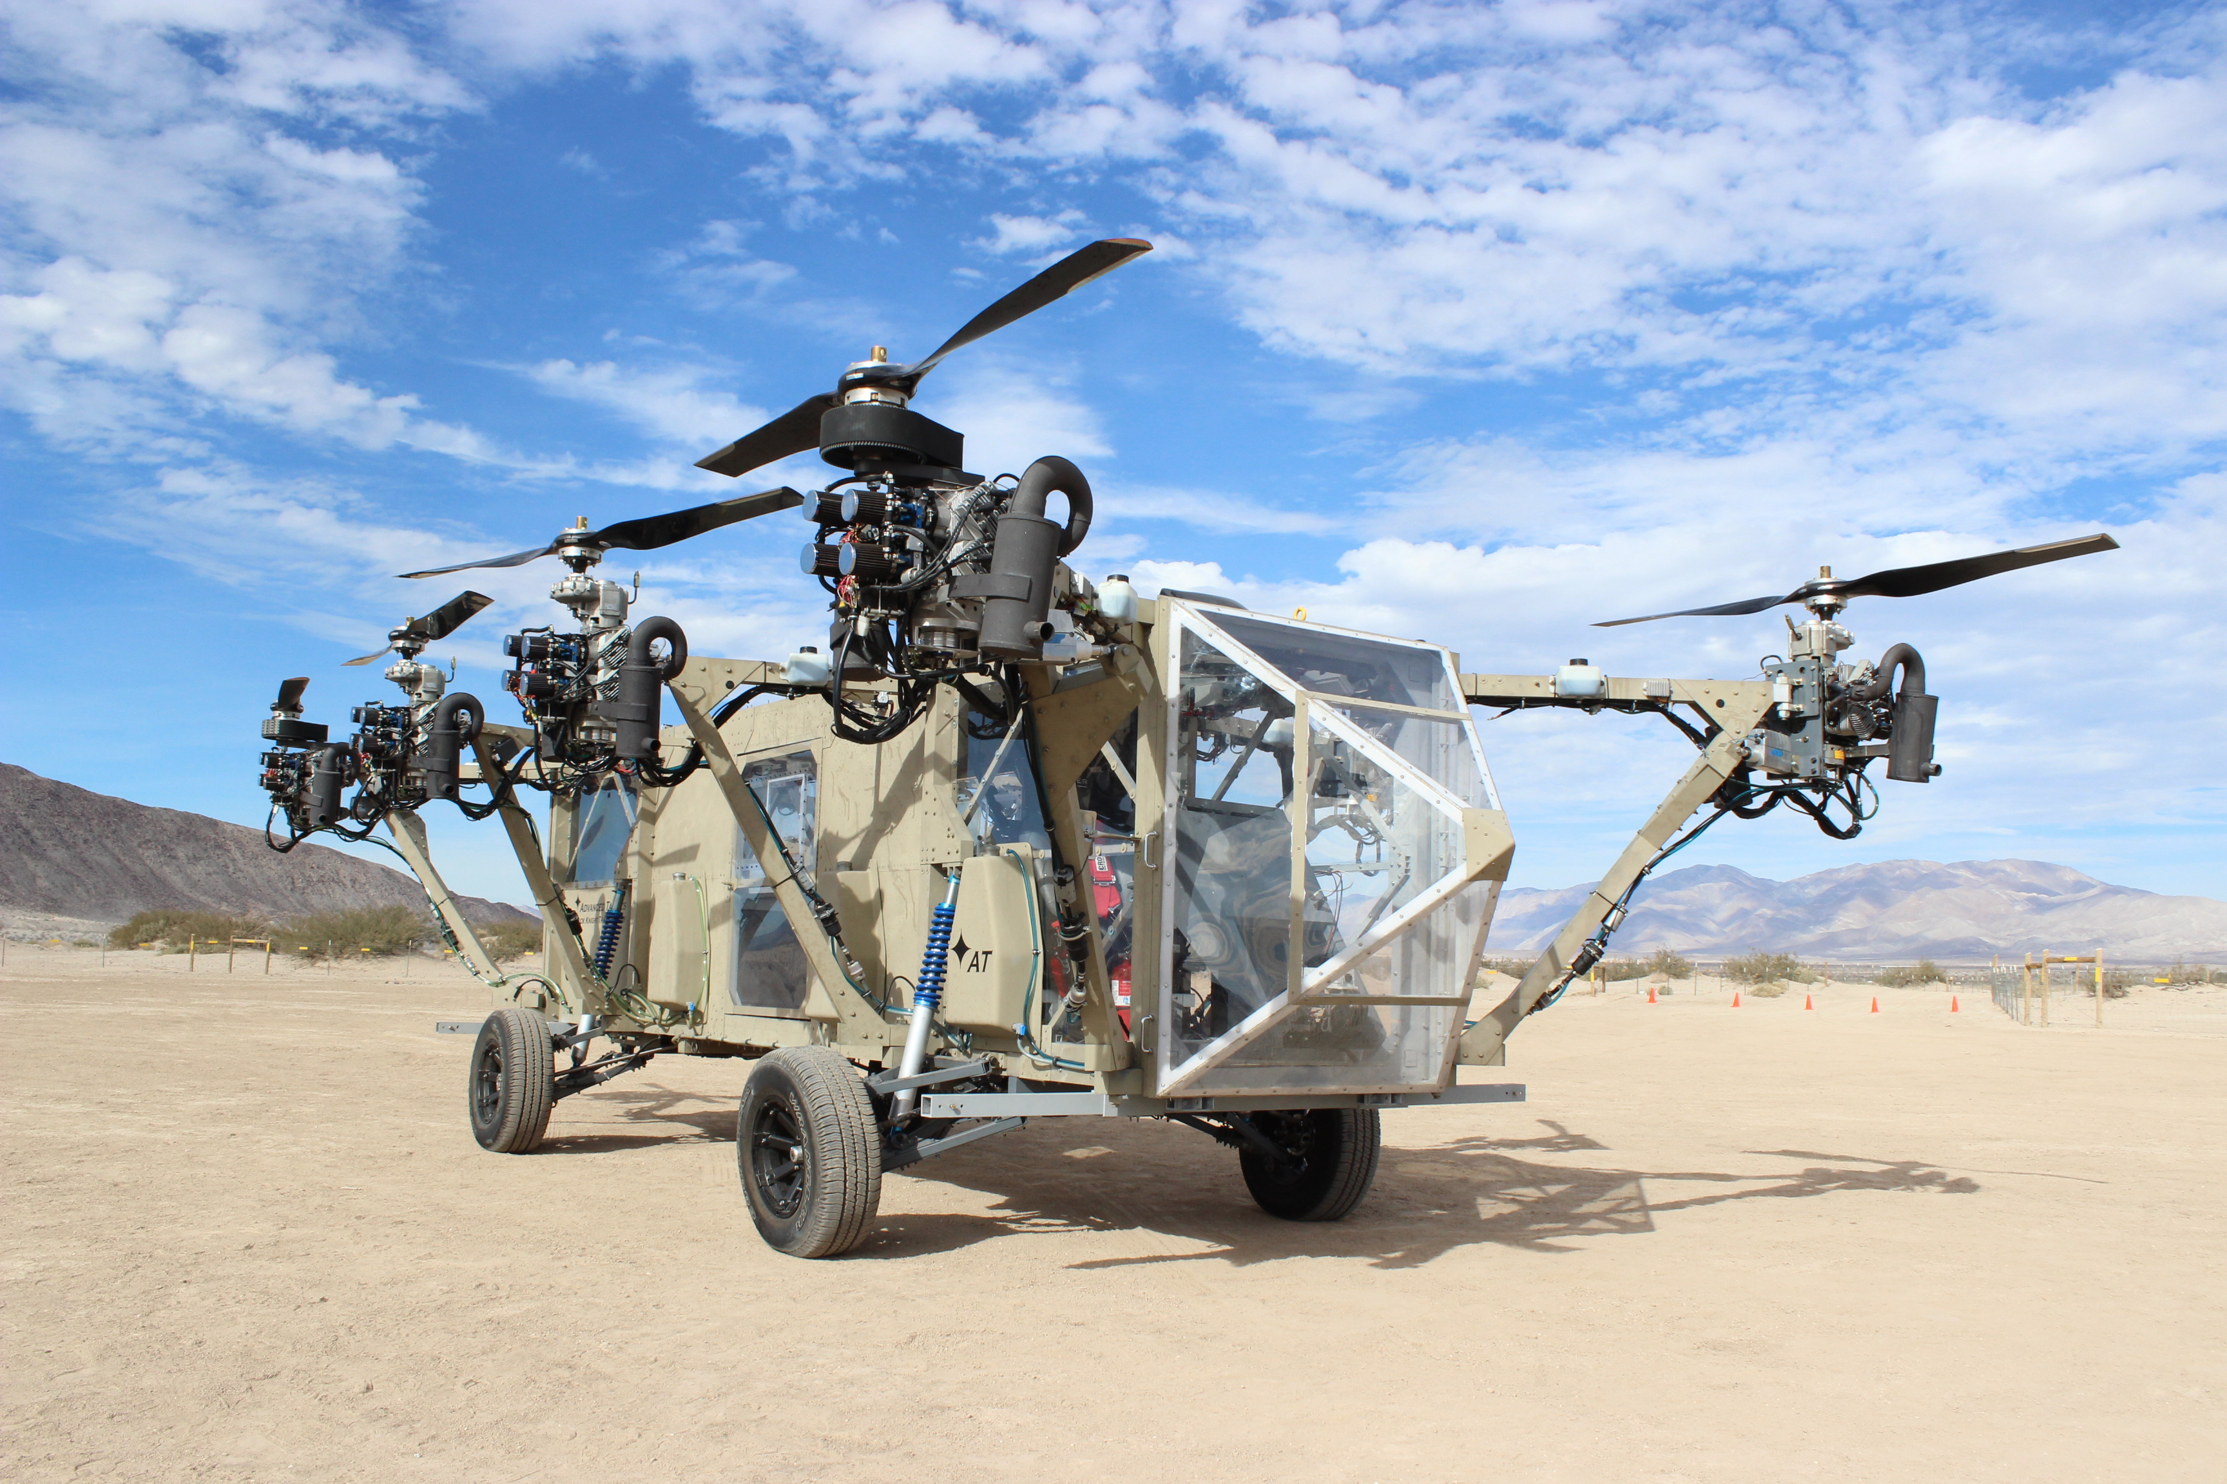
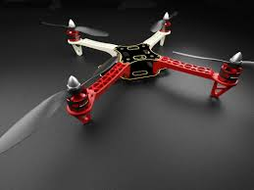
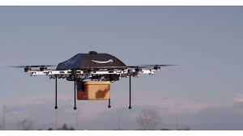
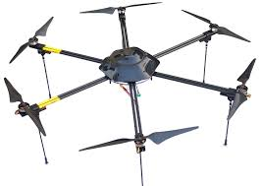

Slide 29
Multirotor Aircraft Components
Airframe
Structural support
Plastic, aluminum, wood, or PCB (fiberglass)
Motors
Lift, movement, and control
Brushed DC motors for small craft
Brushless brushless DC motors for large craft.
Inertial Measurement Unit (IMU)
Sensing the aircraft’s orientation and movement
Gyroscopes and accelerometers.
Computing resources (microcontroller/processor)
To run the flight control software
Manage communication
Flight control software
Provides stability using the IMU and motors
Converts pilot commands to motor outputs
Radio
For receiving command
Returning telemetry.
Power supply
Lots of power for the motors
Carefully regulated power for the IMU and micro controller.

Slide 30
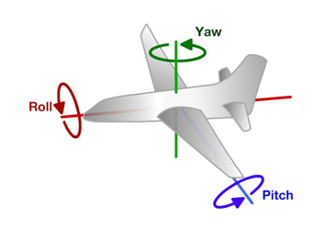
Principles of Operation (1)
An even number of motors provides lift and control in 6 dimensions
Spatial dimensions: x, y, z
Pitch: rotation around left-right (y) axis
Roll: rotation around the front-back (x) axis
Yaw: rotation around the top-bottom (z) axis
A flight computer operates a closed-loop controller to maintain stability and implement pilot commands.
Z
X
Y

Slide 31
Controlling Pitch
Pitch forward
More thrust to the rear
Less to the front
Pitch backward
Less thrust to the rear
More to the back

Slide 32
Controlling Roll
Pitch Left
More thrust to the right motor
Less to the left
Pitch Right
More thrust to the left motor
Less to the Right

Slide 33
Controlling Yaw
Rotate CCW
More thrust to the CCW motors
Less to the CW
Rotate CW
More thrust CW motors
Less to the CCW

Slide 34
Some Possible Configurations
Hexa +
Hexa x
“Plus”
“X”
Octa +
Octa x
“Octothorpe”
Y 6

Slide 35
Maintaining Stability
Multi-rotor aircraft are inherently unstable
Mismatched motor power (voltage variation, manufacturing variation in motors or props)
Variation in air currents and density.
Once perturbed, there’s no force acting on the aircraft to return it to equilibrium.

Slide 36
Maintaining Stability
Multi-rotor aircraft require a closed loop controller
Sensors detect aircraft movement and orientation
Controller adjusts the power to motors to maintain desired location and orientation
Multi-rotor aircraft use a few sensors to maintain stability
Accelerometers (absolute pitch and roll)
Gyroscopes (changes in pitch, roll, and yaw)
The flight computer implements the control algorithm
Usually a proportional, integral, derivative (PID) controller implemented in software.
We will talk more about this later.
With PID controllers for pitch, yaw, and roll multirotor aircraft can achieve stable flight.

Slide 37
Higher-order Navigation
Large multi-rotor aircraft can do more
Maintain geographic position
Maintain altitude
Follow an prescribed/pre-programmed path
More sensors required
Magnetometers (absolute yaw or heading)
GPS (absolute location and altitude)
Barometers (altitude)

Slide 38
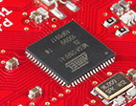
Flight Computer
ATmega128RFA1 microcontroller
Arduino compatible
16Mhz clock
128KB Flash
16KB SRAM
4096B EEPROM
2.4GHz radio (Compatible with Zigbee)

Slide 39
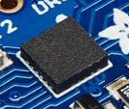
Inertial Measurement Unit
STMicro LSM9DS0
9-axis sensor
3-axis accelerometer
3-axis magnetometer
3-axis gyroscope
I2C interface (more on this later)

Slide 40
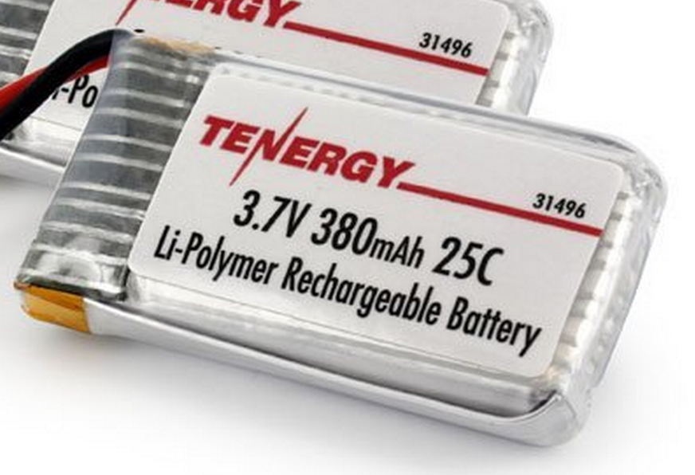
Power Supply
Lithium Polymer Battery
370 Mah
Max 9.25 Amps
Nominal voltage = 3.7V
Powers the motors directly
3.0V low dropout (LDO) voltage regulator
Powers the microcontroller and the IMU
Why 2.7 or 3V instead of 3.3V?

Slide 41
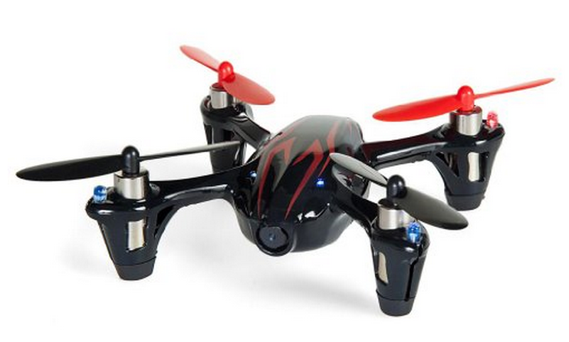
Motors and Props
Suitable motors are hard to find in small quantities.
Correct-fitting props are also a challenge
We will use motors for the Hubsan X4
Purchased as a “crash pack”
Plenty of power
DC brushed motors
They draw ~2A each.

Slide 42
Motor Driver
Pulse-width modulation (PWM)-controlled MOSFET
The microcontroller will drive the MOSFET
The MOSFET will drive current to the motor.
A diode handles the inductive load from motor when it’s off.

Slide 43
Wireless Communication
We will use a custom (i.e., designed by you) communication protocol between the controller an the quadcopter.
Why not one of the existing alternatives?
Standard RC radio protocols are analog or closed source.
Zigbee is complex and closed source.

Slide 44
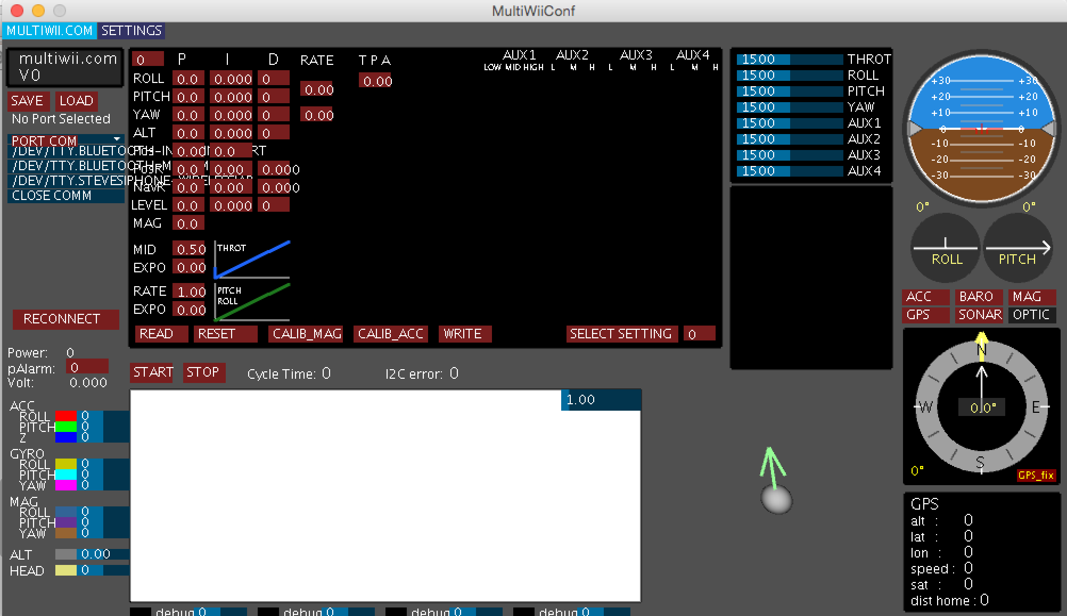
Flight Control Software (Option 1)
Use the MultiWii flight controller software
Open source
Arduino-compatible
Widely used
A GUI
(but not with out it’s idiosyncracies)
You’ll implement the PID controller.

Slide 45
Flight Control Software (Option 2)
Write it from scratch
We will still use the GUI

Slide 46
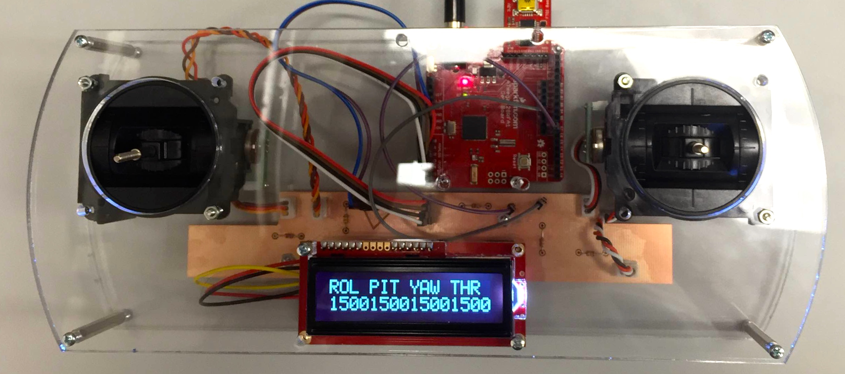
Controller
The controller sends commands to the quadcopter via the radio.
We have a controller design ready for you
It uses the same microcontroller we are using
You’ll be able to customize it a bit.

Slide 47
What You Will Build

Slide 48
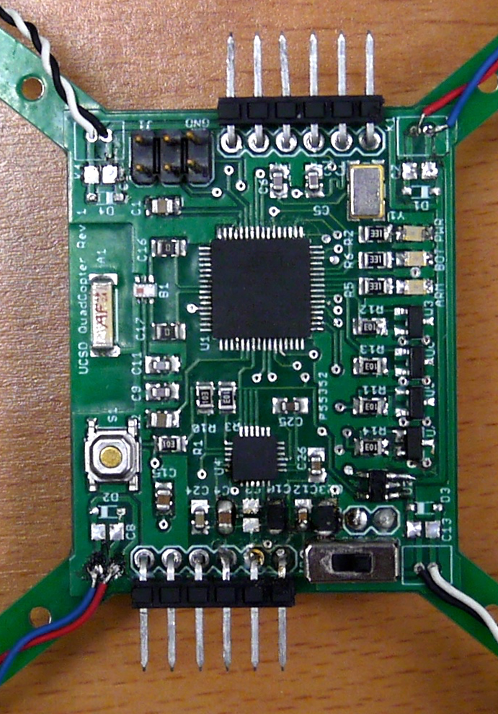
What You Will Build

